Slide 1
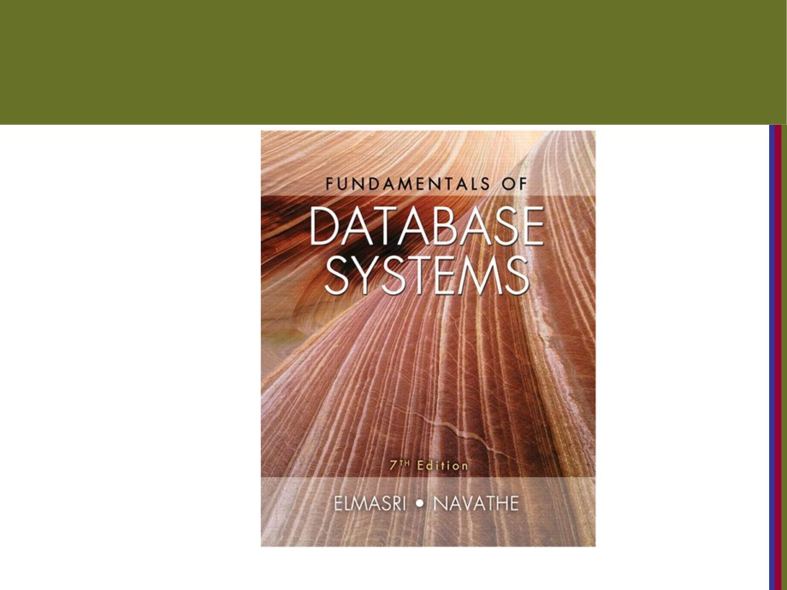
Copyright © 2016 Ramez Elmasri and Shamkant B. Navathe

Slide 2

CHAPTER 1
Databases and Database Users
Copyright © 2016 Ramez Elmasri and Shamkant B. Navathe
Slide 1- 2

Slide 3
OUTLINE
■ Types of Databases and Database Applications  Basic Definitions
■ Typical DBMS Functionality
■ Example of a Database (UNIVERSITY)
■ Main Characteristics of the Database Approach  Types of Database Users
■ Advantages of Using the Database Approach
■ Historical Development of Database Technology  Extending Database Capabilities
■ When Not to Use Databases
Copyright © 2016 Ramez Elmasri and Shamkant B. Navathe
Slide 1- 3

Slide 4
Types of Databases and Database
Applications
■ Traditional Applications:
■ Numeric and Textual Databases(زي معلومات الطلاب ببتكون من اسم ورقم هويه وهي اساس الداتا بيس وما يميزها انه يوجد للمعلومات ستركتشر يعني مثلا كل الطلاب بس تفوت ع البورتال بتشوف تقريبا نفس الاشياء يعني معلومات عناصر هاي الداتا بتكون نفسها  More Recent Applications:
■ Multimedia Databases (الداتا الي بنققدر نحط فيها ارقام وصور وفيديو تكست)
■ Geographic Information Systems (GIS) (زي الخرائط وخطوط الطول وصور الاقمار الصناعيه زي نشرات الاخبار واكبر استخدام لها في البلديات مثلا نوع الارض واذا حدا بدو يفتح طريق )  Data Warehouses(زي شركه الاتصالات عندها كم هائل من المعلومات عن مستخدميها وبتقدر تستغل هاي المعلومات بانها تقدم عروض للمشتركين اذن وظيفه الداتا ويرهاوس انها تجمع هاي البيانات وتعمل لها احصائات مشان تطلع قرارات)
■ Mobile databases(زي لما نعمل مكتبه موسيقى)
■ Real-time and Active Databases(زي نظام تسجيل الجداول في الجامعه انو في وقت ضل بالشعبه واحد يجيبلو انو ضل واحد ولما اسجل فيها ع السريع يغيرها بالنظام )
مثلا الفيس بوك الداتا فيه مش ستركتشر لنو في طلاب بس حاطه صورتها او رقم ومش شرط كل المستخدمين يكونو هيك عاملينن وهذا يسمى نن تردشنال
Copyright © 2016 Ramez Elmasri and Shamkant B. Navathe
Slide 1- 4

Slide 5
Recent Developments (1)
■ Social Networks has required the creation of
huge databases that store non traditional data
Such as-posts, tweets, photos, videos in systems
such as:
- Facebook
- Twitter
- Linked-In
■ All of the above constitutes data
Copyright © 2016 Ramez Elmasri and Shamkant B. Navathe
Slide 1- 5

Slide 6
Recent Developments (2)
■ New Technologies are emerging from
software vendors above to manage vast amounts of data generated on the web:
■ Big Data storage systems involving large clusters of distributed computers
■ NOSQL (Not Only SQL) systems
الاس كيو ال تستخدم عند التردشنال داتا و النت اونلي اس كيو هاي تستخدم في وسائل التوصال مثل جوجل وفيس لانو بكون فيها كميات كبيرة من التخزين للداتا ومنشان تكون قادر على ادارة هاي البيانات
Copyright © 2016 Ramez Elmasri and Shamkant B. Navathe
Slide 1- 6

Slide 7
Basic Definitions
■ Database:
■ A collection of related data.(يعني زي داتا الطلاب وبتكون مترابطه مع بعضها اما مش رليتد زي بيانات طلاب مع مهندسين)  Data:
■ Known facts that can be recorded and have an implicit meaning.  Mini-world(زي الجامعه المستشفى البنك يعني ما منعمل داتا لكل اشي بالحياة)
■ Some part of the real world about which data is stored in a database. For example, student grades and transcripts at a
university.
■ Database Management System (DBMS)(هاد هو الي بخلي الداتا بيس قويه هاد هو الي بسمحلي اصنع الداتا بيس واعملها ادارة مقل اوراكل)
■ A software package/ system to facilitate(يسهل)فاسيليتي the creation(خلق) and maintenance(اعمال صيانه)ميتننس of a computerized database.
■ Database System:
■ The DBMS software together with the data itself(الداتا بيس سستم هو عبارة عن الداتا بيس منجمنت والداتا نفسها). Sometimes, the applications are also included.
الداتا تبعتي محيمه ويمكن الها يوز وباس مشان ندخل عليها ولي بوفر هاي الميزة هو الداتا بيس منجمنت سستم
Copyright © 2016 Ramez Elmasri and Shamkant B. Navathe
Slide 1- 7

Slide 8
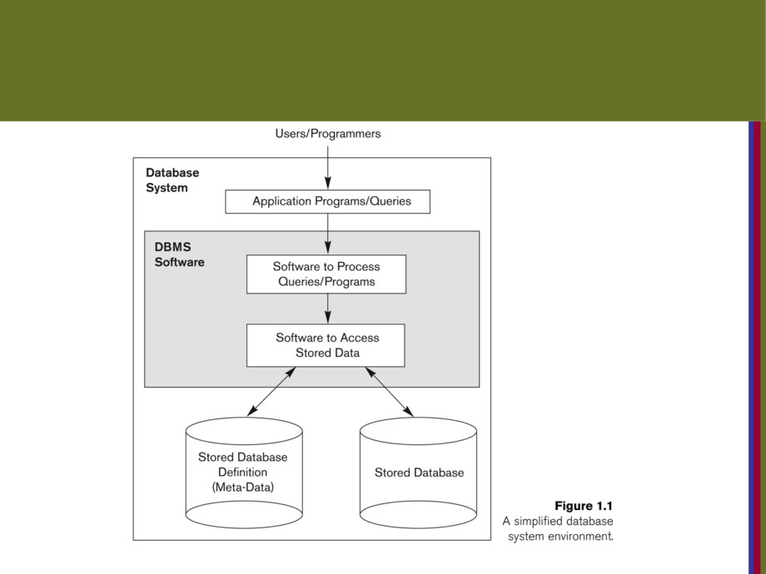
Simplified database system environment
الميتا داتا هي زي دكلريشن للمتغيرات يعني زي كلمه دبل معناها بكون داتا اباوت داتا
الابلكيشن برجرام يعني زي برامج بتكون مكتوبه بالويب او السي او أي لغه ومن خلالها بقدر اتصل بالداتا بيس واشغلها
الكويرز الا هي الاوامر المباشرة
Copyright © 2016 Ramez Elmasri and Shamkant B. Navathe
Slide 1- 9

Slide 9
Impact of Databases and Database
Technology
■ Businesses: Banking, Insurance(التامينات), Retail(التجزئه زي السوبر ماركت),
Healthcare
■ Service Industries: Financial, Real-estate(سوق العقار), Legal(القوانين), Electronic Commerce
■ Education : Resources for content and Delivery  More recently: Social Networks, Medicine and
Genetics
■ Personalized Applications: based on smart mobile devices
Copyright © 2016 Ramez Elmasri and Shamkant B. Navathe
Slide 1- 8

Slide 10
Typical DBMS Functionality(شو بتسمحلي اساوي)
■ Define a particular database in terms of its data types, structures(الا هي الجداول), and constraints(الشروط زي ايدي الطالب مش نفس غيرو وعدد الطلاب يقفل عند حد معين بالشعبه )
■ Construct or Load the initial database contents on a secondary storage medium(يعني اني بقدر اعبيها من فايل)
■ Manipulating the database:
■ Retrieval: Querying, generating reports
■ Modification: Insertions, deletions and updates to its content  Accessing the database through Web applications  Processing and Sharing by a set of concurrent users and application programs - yet, keeping all data valid and consistent
رليشنل داتا بيس الا هي الداتا بيس المبنيه ع الجداول
Copyright © 2016 Ramez Elmasri and Shamkant B. Navathe
Slide 1- 10

Slide 11
Application Activities Against a
Database
■ Applications interact with a database by generating
- Queries: that access different parts of data and formulate the result of a request(يعني عمليه وحدة خلال ار واحد زي اسحب مصاري من فلان)
- Transactions(عدة عمليات تعامل كوحدة واحدة يعني يا كلهن بتنفذن يلا لا): that may read some data and
“update” certain values or generate new data and store that in the database(بكون عمله زي النقل يعني اسحب من احمد واعطيهن لعمر/هاي بتنقل من ستيت لستيت)
■ Applications must not allow unauthorized users to access dataيعني ما بتسمح الا لي الهم سماح بالوصل لهاي البيانات
■ Applications must keep up with changing user
requirements against the databaseيعني انو الابلكيشين لازم تتطور مع أي تغير عليها
Copyright © 2016 Ramez Elmasri and Shamkant B. Navathe
Slide 1- 11

Slide 12
Additional DBMS Functionality
■ DBMS may additionally provide:
■ Protection or Security measures to prevent unauthorized access
■ Presentation and Visualization of dataيعني زي فلوتشارت  Maintenance of the database and associated programs over the lifetime of the database application
Copyright © 2016 Ramez Elmasri and Shamkant B. Navathe
Slide 1- 12

Slide 13
Example of a Database
(with a Conceptual Data Model)
■ Mini-world for the example:
■ Part of a UNIVERSITY environment.  Some mini-world entities:
■ STUDENTs
■ COURSEs
■ SECTIONs (of COURSEs)  (academic) DEPARTMENTs  INSTRUCTORs
Copyright © 2016 Ramez Elmasri and Shamkant B. Navathe
Slide 1- 13

Slide 14
Example of a Database
(with a Conceptual Data Model)
■ Some mini-world relationships:
■ SECTIONs are of specific COURSEs  STUDENTs take SECTIONs
■ COURSEs have prerequisite COURSEs  INSTRUCTORs teach SECTIONs  COURSEs are offered by DEPARTMENTs  STUDENTs major in DEPARTMENTs
■ Note: The above entities and relationships are typically expressed in a conceptual data model, such as the ENTITY-RELATIONSHIP data model (see Chapters 3, 4)
Copyright © 2016 Ramez Elmasri and Shamkant B. Navathe
Slide 1- 14

Slide 15
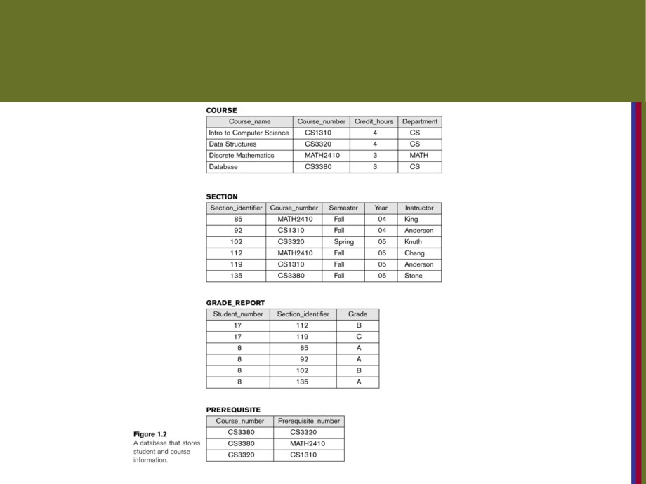
Example of a simple database
Copyright © 2016 Ramez Elmasri and Shamkant B. Navathe
Slide 1- 15

Slide 16
Main Characteristics of the Database
Approachالخصائص الرئيسيه لنهج قوعاد البيانات
■ Self-describing nature of a database system:
■ A DBMS catalog(بحتوي ع الميتا داتا وهذا شيء حسن للريشنال داتا) stores the description of a particular database (e.g. data structures, types, and constraints)
■ The description is called meta-data*.ف الريسنت ابلكيشن فش عندهم كتلوج للميتا داتا لانو الداتا هناك ما بتكون ستركتشر
■ This allows the DBMS software to work with different database applications.
■ Insulation between programs and data:
■ Called program-data independence.
■ Allows changing data structures and storage organization without having to change the DBMS access programs.يعني يمكن بس تكبر الجامعه يضيفو حقول جديدة للجاول ويمكن يضيفو جداول جديدة بس البرمجيات الي بنشتغل عليها ما بتتغير
-----------------------------------------------------------------------------
يعني اذا غيرنا البرجرام ما بغير ع الداتا اشي بس اذا غيرنا ع الداتا يمكن ان يتغير ع البرجرام ويمكن ما يغير حسب وين انت عملت التغير
Copyright © 2016 Ramez Elmasri and Shamkant B. Navathe
Slide 1- 16

Slide 17
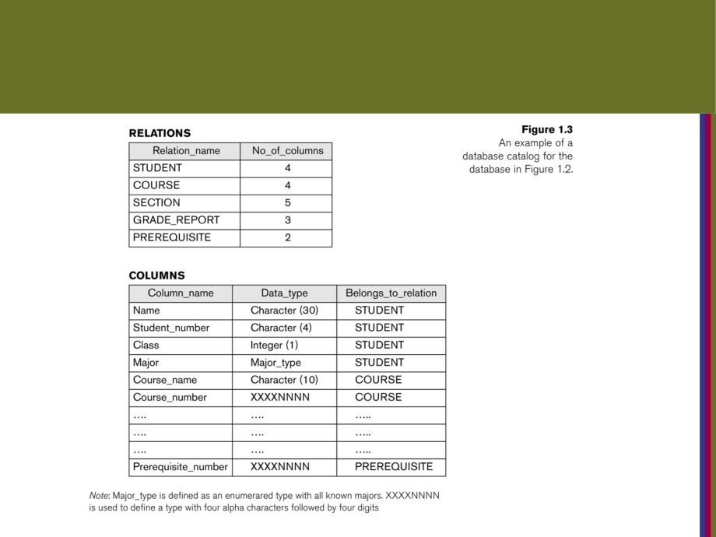
Example of a simplified database catalog
Copyright © 2016 Ramez Elmasri and Shamkant B. Navathe
Slide 1- 17

Slide 18
Main Characteristics of the Database
Approach (continued)
■ Data Abstraction:
■ A data model is used to hide storage details and present the users with a conceptual view of the database.يعني انه ما بهمني كيف مخزن الداتا بتفاصيلها جوا بس المهم انو يعرضلي ياها كونسبشل يعني بشكل ملائم
■ Programs refer to the data model constructs rather than data storage details
■ Support of multiple views of the data:
■ Each user may see a different view of the database, which describes only the data of interest to that user.يعنيانو بورتال الطلاب نفسه يعني نفس الفيو
Copyright © 2016 Ramez Elmasri and Shamkant B. Navathe
Slide 1- 18

Slide 19
Main Characteristics of the Database
Approach (continued)
■ Sharing of data and multi-user transaction processing:
■ Allowing a set of concurrent users to retrieve from and to update the database.يعني انو الداتا بتسمح محموعه من الناس انها تدخل بنفس الوقت ع الدتا وتعدل عليها زي تسجيل العشب
■ Concurrency control within the DBMS guarantees that each transaction is correctly executed or abortedيعني لما اسجل كل الشعب لازم اعمل تثبيت مشان ما يروح الشغل
■ Recovery subsystem ensures each completed transaction has its effect permanently recorded in the databaseاسترجاع بعد العطل
■ OLTP (Online Transaction Processing) is a major part of database applications. This allows hundreds of concurrent
transactions to execute per second.
Copyright © 2016 Ramez Elmasri and Shamkant B. Navathe
Slide 1- 19

Slide 20
Database Users
■ Users may be divided into
■ Those who actually use and control the database content, and those who design, develop and maintain database applications (called “Actors on
the Scene”), كل من يستعمل الدتا بيس
■ Those who design and develop the DBMS
software and related tools, and the computer systems operators (called “Workers Behind the
Scene”).الي بصنع اجزاءاو ادوات من الداتا بيس منجمنت
Copyright © 2016 Ramez Elmasri and Shamkant B. Navathe
Slide 1- 20

Slide 21
Database Users - Actors on the Scene
■ Actors on the scene
■ Database administrators:
■ Responsible for authorizing access to the database, for coordinating and monitoring its use, acquiringالحصول
software and hardware resources, controlling its use
and monitoring efficiency of operations.  Database Designers:
■ Responsible to define the content, the structure, the constraints, and functions or transactions against
the database. They must communicate with the end-users and understand their needs.
Copyright © 2016 Ramez Elmasri and Shamkant B. Navathe
Slide 1- 21

Slide 22
Database End Users
■ Actors on the scene (continued)
■ End-users: They use the data for queriesاستعلامات, reports and some of them update the database content. End-users can be categorized into:يقسم الى 4
■ Casualالعارض: access database occasionallyاوكيجيونلي(من حين لاخر) when needed ( high level managers)
■ Naïve or Parametric: they make up a large section of the end-user population.
■ They use previously well-defined functions in the form of “canned transactions” against the database.
■ Users of Mobile Apps mostly fall in this categoryمستخدمين تطبيقات الجوال مع هاي الفئه
■ Bank-tellersالموظفين الي بضل اكثر اشي يشتغل ع الداتا or reservation clerks are parametric users who do this activity for an entire shift of operations.
Copyright © 2016 Ramez Elmasri and Shamkant B. Navathe
Slide 1- 22

Slide 23
Database End Users (continued)
■ Sophisticated:سفستكيتد
■ These include business analystsخذول الي بحللو الداتا الي ف الوير هاوس, scientists, engineers, others thoroughly familiar with the system capabilities.
■ Many use tools in the form of software packages that work closely with the stored database.
■ Stand-alone:
■ Mostly maintain personal databases using ready-to-use packaged applications.يحتفظ بقواعد البيانات الشخصيه باستخدام تطبيقات جاهزة للاستخدام
■ An example is the user of a tax program that creates its own internal database.
■ Another example is a user that maintains a database of personal photos and videos.
Copyright © 2016 Ramez Elmasri and Shamkant B. Navathe
Slide 1- 23

Slide 24
Database Users - Actors on the
Scene (continued)
■ System Analysts and Application Developers
This category currently accounts for a very large proportion of the IT work force.بحكي انو هاي الفئه تحتل نسبه كبيرة من قوه العمل
■ System Analysts: They understand the user
requirements of naïve and sophisticated users and design the
applications //including canned transactions to meet those
requirements.
■ Application Programmers: Implement تنفيذthe
specifications developed by analysts .and test and debug them before deployment.
■ Business Analysts: There is an increasing need for such people who// they can analyzeتحليل vast amounts of business data and real-time data (“Big Data”) for making a better decision related to planning, advertising, marketing etc.
Copyright © 2016 Ramez Elmasri and Shamkant B. Navathe
Slide 1- 24

Slide 25
Database Users - Actors behind the
Scene
■ System Designers and Implementors: Design and
implement DBMS packages in the form of modules and
interfaces and test and debug them. The DBMS must interface with applications, language compilers, operating system components, etc.
■ Tool Developers: Design and implement software
systems called tools for modeling and designing databases, prototyping, test data generation,simulation etc.
that facilitate building of
تسهل بناء التطبيقات وتسمح باستخدام قاعدة البيانات بشكل فعال
applications and allow using database effectively.
■ Operators and Maintenance Personnel: They
manage the actual database system hardware and software environment.
Copyright © 2016 Ramez Elmasri and Shamkant B. Navathe
Slide 1- 25

Slide 26
Advantages of Using the Database
Approach
■ Controlling redundancyالتكرار in data storage and in development and maintenance efforts.يعني الداتا تكون بمطرح واحد يعني الداتا الطالب بتكون مرة وحدة وبتتوزع حسب متطلبات النظام
■ Sharing of data among multiple users.
■ Restricting unauthorized access to data. Only the DBA staff uses privileged commands and
facilities.
■ Providing persistent storage for program Objectsيعني الداتا بتضل ما بتروح ع طول الزمن
■ E.g., Object-oriented DBMSs make program objects persistent- see Chapter 12.
■ Providing Storage Structures (e.g. indexes) for
efficient Query Processing - see Chapter 17.زي فهرس الكتاب
Copyright © 2016 Ramez Elmasri and Shamkant B. Navathe
Slide 1- 26

Slide 27
Advantages of Using the Database
Approach (continued)
■ Providing optimization of queries for efficient processing.
■ Providing backup and recovery services.
■ Providing multiple interfaces to different classes of users.الواجهة يلي بتظهر للطلاب ف البورتال مش نفسها تبعت الدكتور
■ Representing complex relationships among data.  Enforcing integrity constraints on the database.  Drawing inferences and actions from the stored
data using deductive and active rules and triggersهاد برنامج بتخزن جوا الداتابيس ويشتغل في وقت معين .
Copyright © 2016 Ramez Elmasri and Shamkant B. Navathe
Slide 1- 27

Slide 28
Additional Implications of Using the
Database Approach
■ Potential for enforcing standardsامكانيه تطبيق المعاير:
■ This is very crucial for the success of database
applications in large organizationsبحكي انه هاي اهم اشي لنجاح قواعد البيانات. Standards
refer to data item names, display formats, screens,
report structures, meta-data (description of data),
Web page layouts, etc.
■ Reduced application development time:
■ Incremental time to add each new application is reduced.
Copyright © 2016 Ramez Elmasri and Shamkant B. Navathe
Slide 1- 28

Slide 29
Additional Implications of Using the
Database Approach (continued)
■ Flexibility to change data structures:
■ Database structure may evolve as new requirements are defined.
■ Availability of current informationتوفر المعلومات الحاليه:
■ Extremely important for on-line transaction systems such as shopping, airline, hotel, car reservations.
■ Economies of scale:
■ Wasteful overlap of resources and personnel can be avoided by consolidating data and applications across departments.
Copyright © 2016 Ramez Elmasri and Shamkant B. Navathe
Slide 1- 29

Slide 30
Historical Development of Database
Technology
■ Early Database Applications:
■ The Hierarchical and Network Models were introduced in mid 1960s and dominated during the seventies.
■ A bulk of the worldwide database processing still occurs using these models, particularly, the hierarchical model
using IBM’s IMS system.
■ Relational Model based Systems:
■ Relational model was originally introduced in 1970, was
heavily researched and experimented within IBM Research
and several universities.
■ Relational DBMS Products emerged in the early 1980s.
Copyright © 2016 Ramez Elmasri and Shamkant B. Navathe
Slide 1- 30

Slide 31
Historical Development of Database
Technology (continued)
■ Object-oriented and emerging applications:
■ Object-Oriented Database Management Systems
(OODBMSs) were introduced in late 1980s and early 1990s to cater to the need of complex data processing in CAD and other applications.
■ Their use has not taken off much.
■ Many relational DBMSs have incorporated object database concepts, leading to a new category called object-relational DBMSs (ORDBMSs)
Copyright © 2016 Ramez Elmasri and Shamkant B. Navathe
Slide 1- 31

Slide 32
When not to use a DBMS
■ costsing of using a DBMS:
■ High initial investment and possible need for additional hardware.
■ Overhead for providing generality, security, concurrency control, recovery, and integrity functions.
■ When a DBMS may be unnecessary:
■ If the database and applications are simple, well defined, and not expected to change.
■ If access to data by multiple users is not required.  When a DBMS may be infeasible:
■ In embedded systems where a general purpose DBMS may not fit in available storage
Copyright © 2016 Ramez Elmasri and Shamkant B. Navathe
Slide 1- 36

Slide 33
Chapter Summary
■ Types of Databases and Database Applications  Basic Definitions
■ Typical DBMS Functionality
■ Example of a Database (UNIVERSITY)
■ Main Characteristics of the Database Approach  Types of Database Users
■ Advantages of Using the Database Approach
■ Historical Development of Database Technology  Extending Database Capabilities
■ When Not to Use Databases
Copyright © 2016 Ramez Elmasri and Shamkant B. Navathe
Slide 1- 38

